Slide 1
Event Hub
By Group 4: Isaiah, Chek Ee, Yong Ting, Haziq, Hnin, Brian

Slide 2
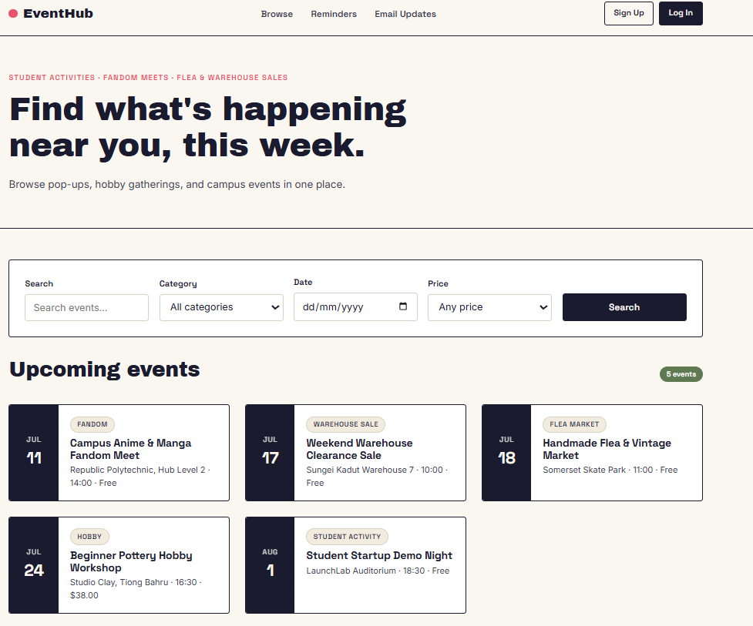
App Idea — EventHub
Project Overview
Web application developed using Node.js, Express.js, MySQL and EJS
Allows users to discover and browse local events
Supports multiple user roles:
Visitor
Organisers
Admin
Provides event reminders, ticket purchasing, reviews, and event management
Target Audience: Students, event organisers, and the general public looking to discover, manage, and attend local events.

Slide 3
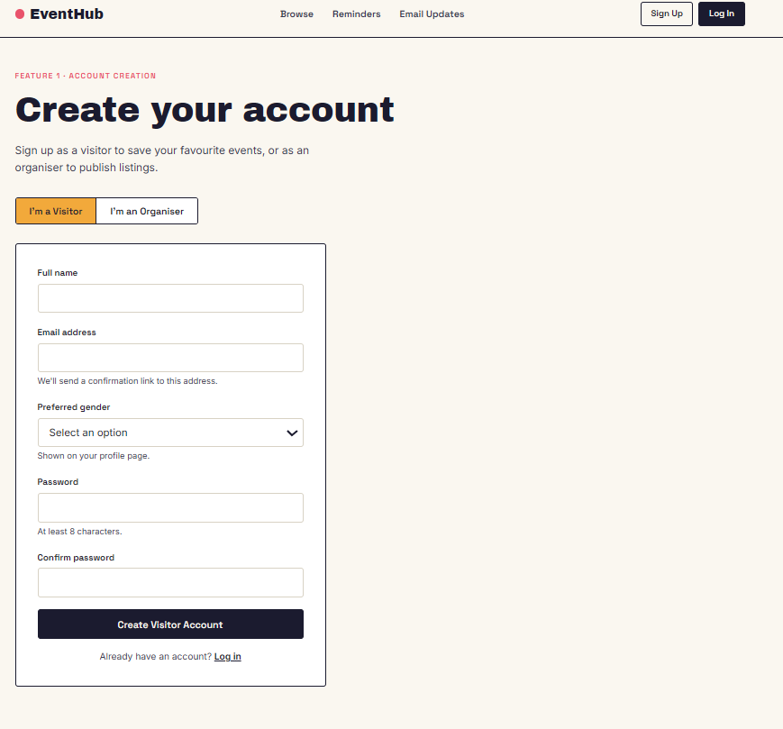
Account creation
Isaiah
The Visitor Sign Up feature allows user to create a visitor account so they can view the available events and save the events they are interested to attend.
Password must have at least 8 characters
The system will check that password meet the minimum length requirement and both password fields are matched. If there is error., the user will be prompted to renter again.
Once the system processed the registration, the account created and the user then can sign in to view the available events

Slide 4
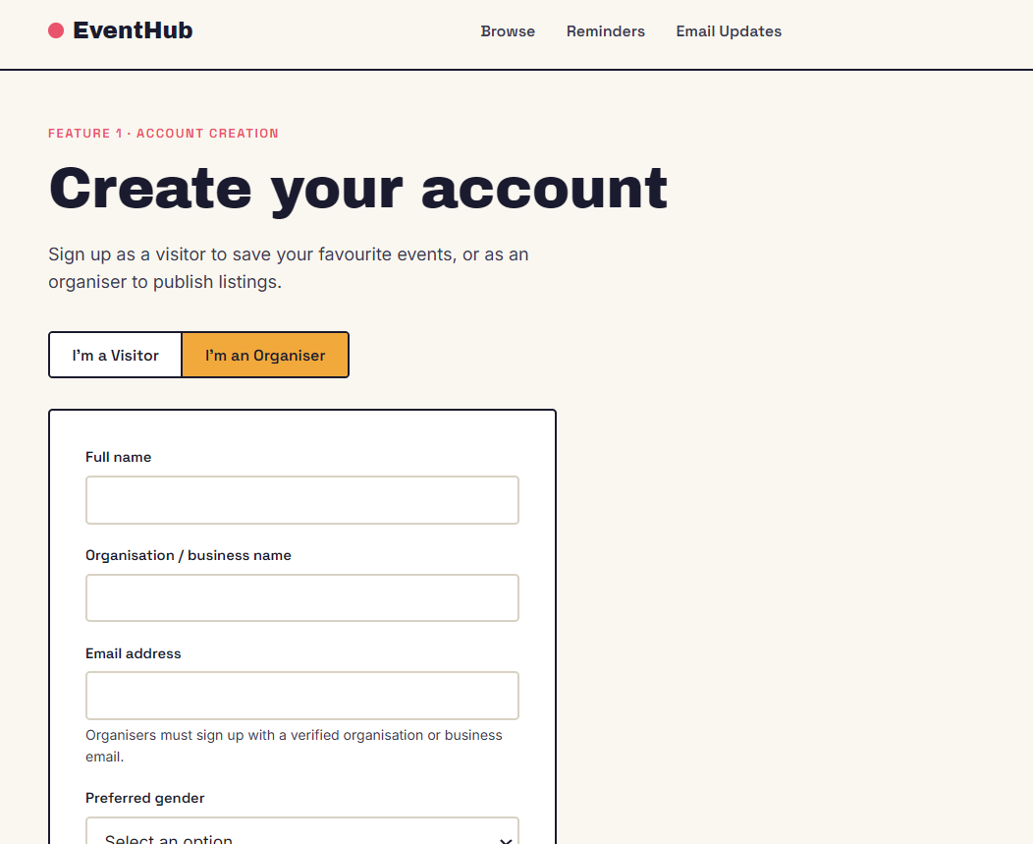
ACCOUNT creation
Isaiah
For Organiser, the sign up is the same as Visitor but with the addition of their Organisation / business name

Slide 5
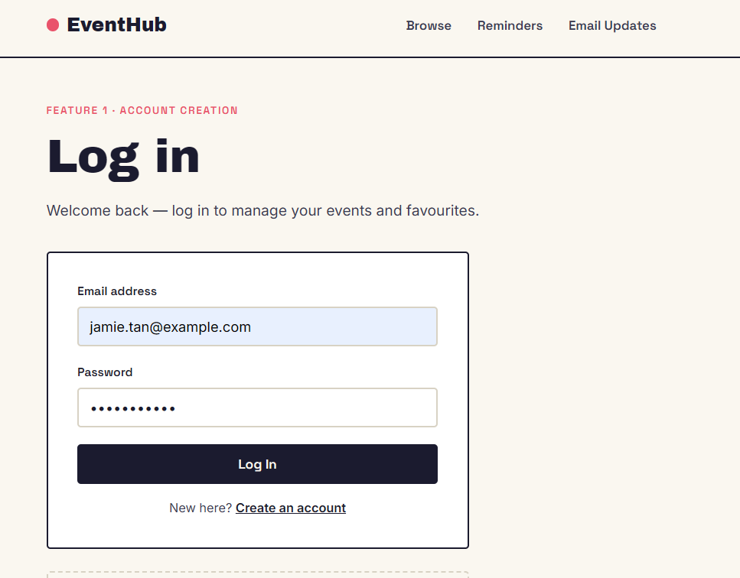
Account webpage
Isaiah
Simple login page that prompts for the user's address and password
Also accessible for admins to log in into
If not logged in, reminders, email updates, ticket purchasing etc will be redirected back to the log in page

Slide 6
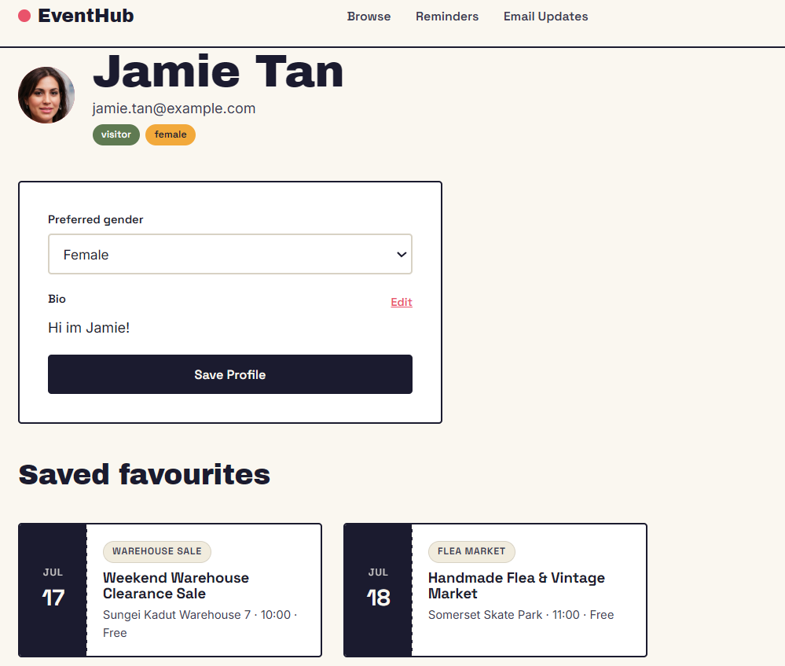
Account webpage
Isaiah
Able to see your name and email
Specifies if you're a visitor or organiser and their gender
A Bio to explain about themselves
Able to show their saved favourites for upcoming events

Slide 7
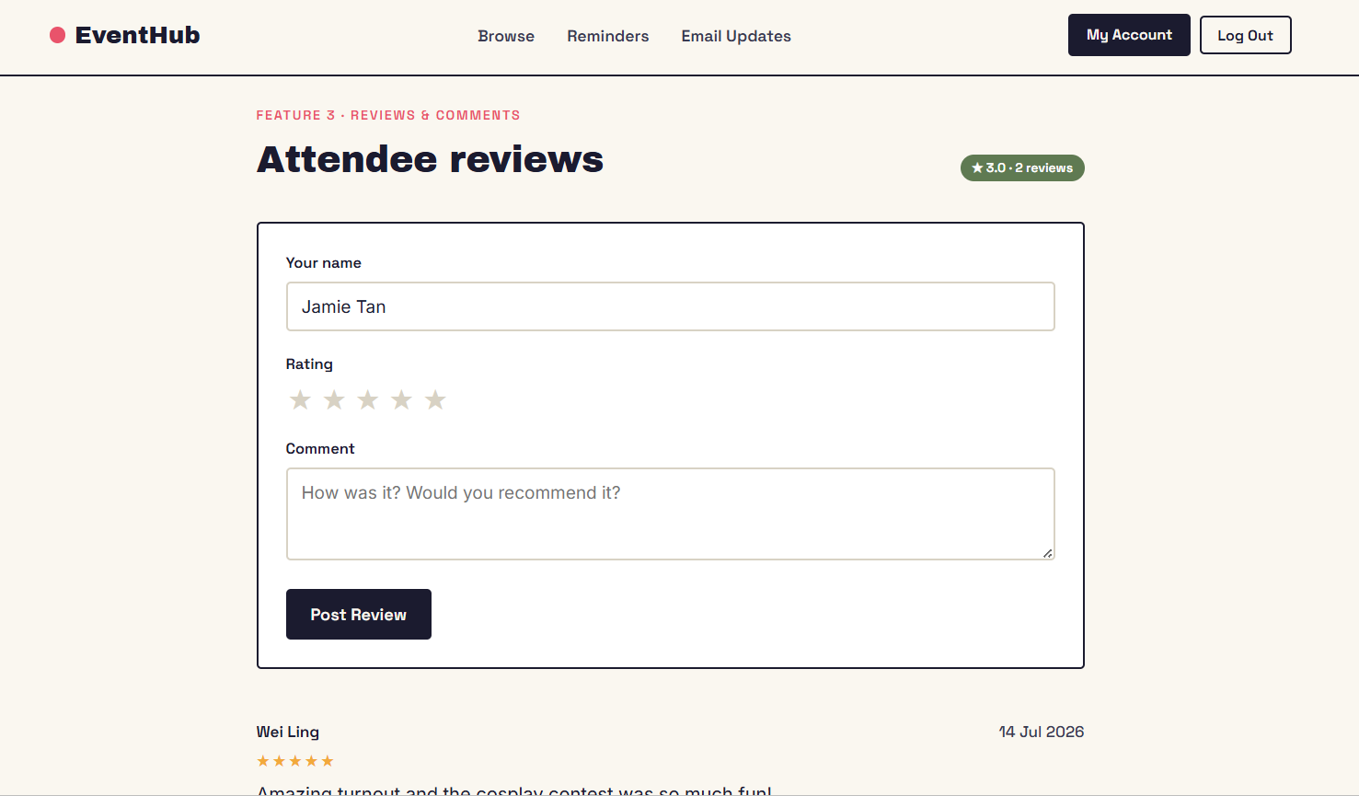
User Review and commentary
Chek Ee
-Has a star system for rating
-Allows user to add comments
-Require users to add their name rating and comments.
-Autofill the user's name

Slide 8
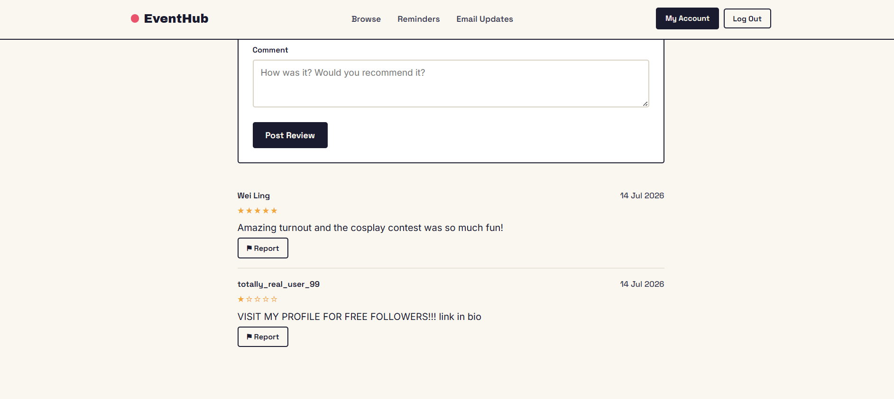
User review and comments
Chek Ee
Displays the review
Allow users to report the review

Slide 9
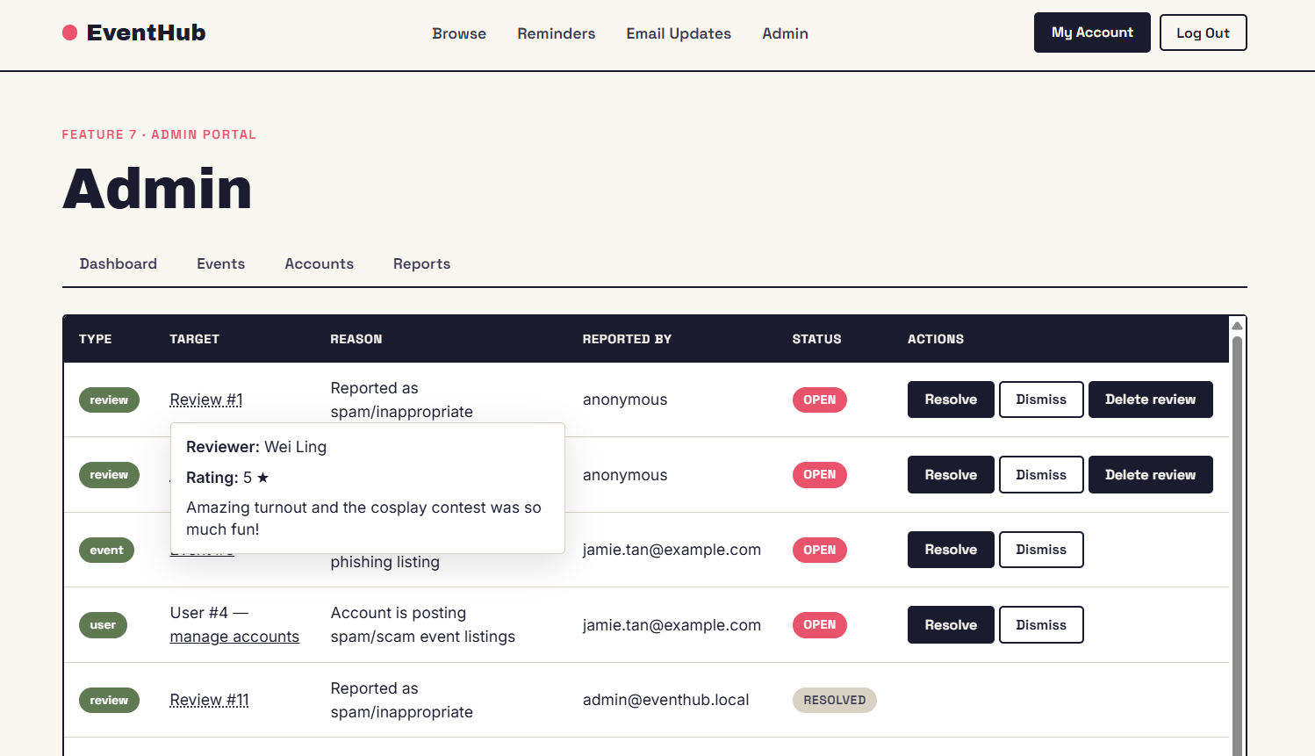
User Review and commentary (Admin side)
Chek Ee
-Allows hover over the review to see details
-Able to delete the review from the database

Slide 10
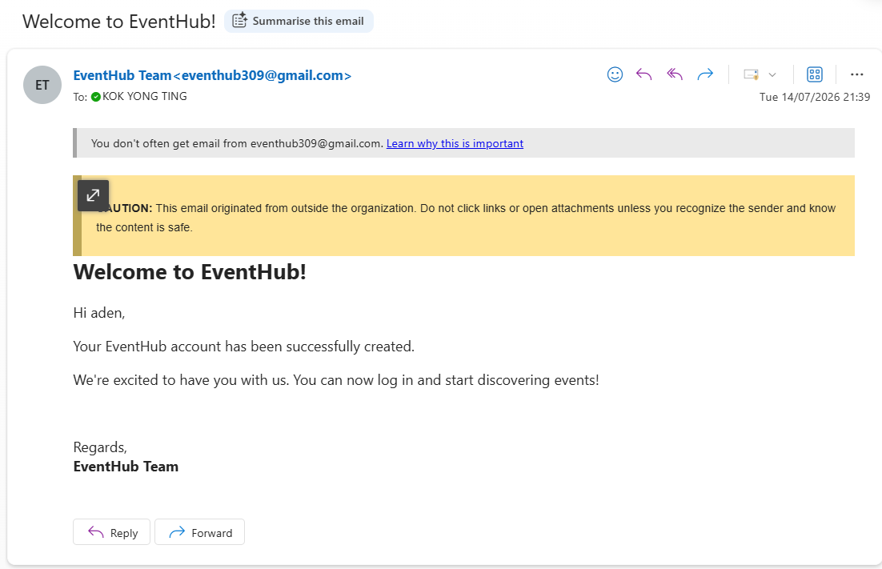
EMAIL SYSTEM
Yong Ting
Website sends Welcome email after user successfully registers new account

Slide 11
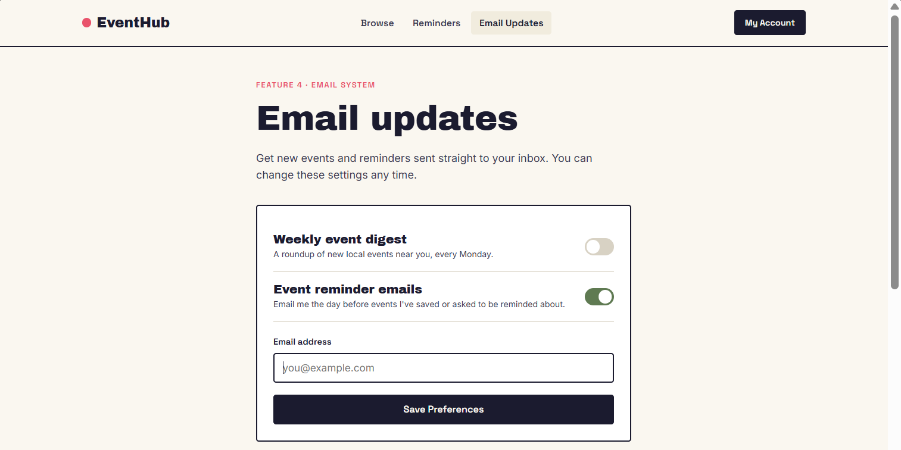
Email system
Yong Ting
Manage email subscription preferences
Receive event reminder emails
Update contact email
Preview weekly event digest

Slide 12
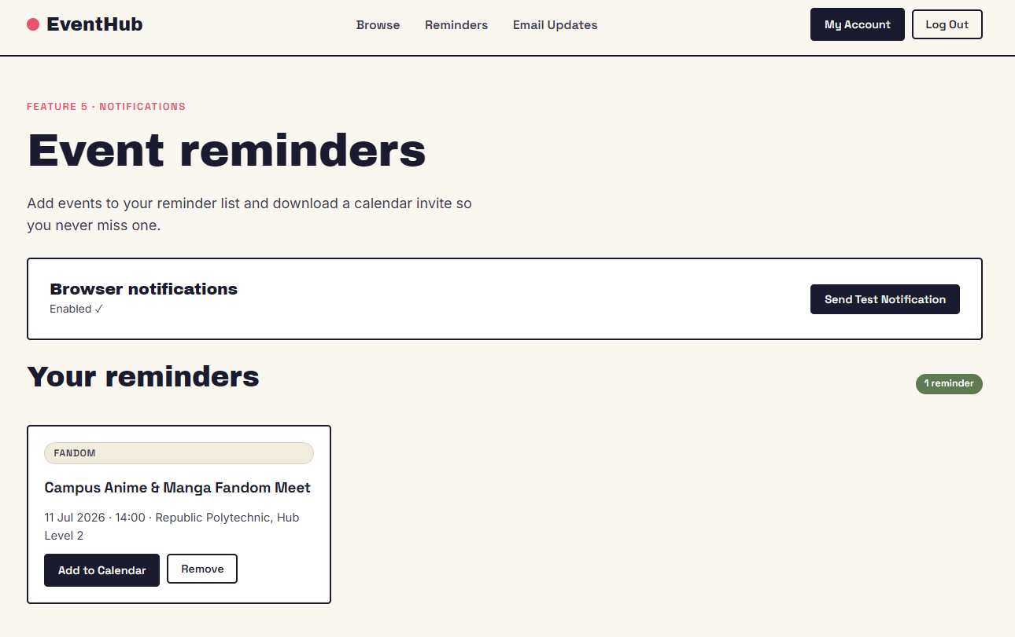
Notifications / reminders
Haziq
Save events to local calendar for easier event tracking
Send reminders through email and browser notifications
Notify users about upcoming events and important updates

Slide 13
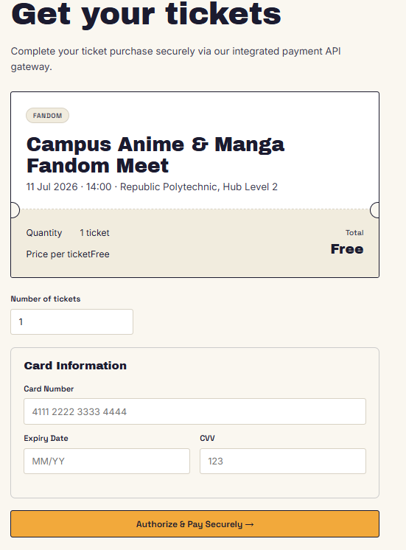
ticketing
Hnin
Allows users to get digital tickets
Creates a ticket after a successful event registration
Helps organizers keep track of event participants
Makes event check-in easier by using ticket information

Slide 14
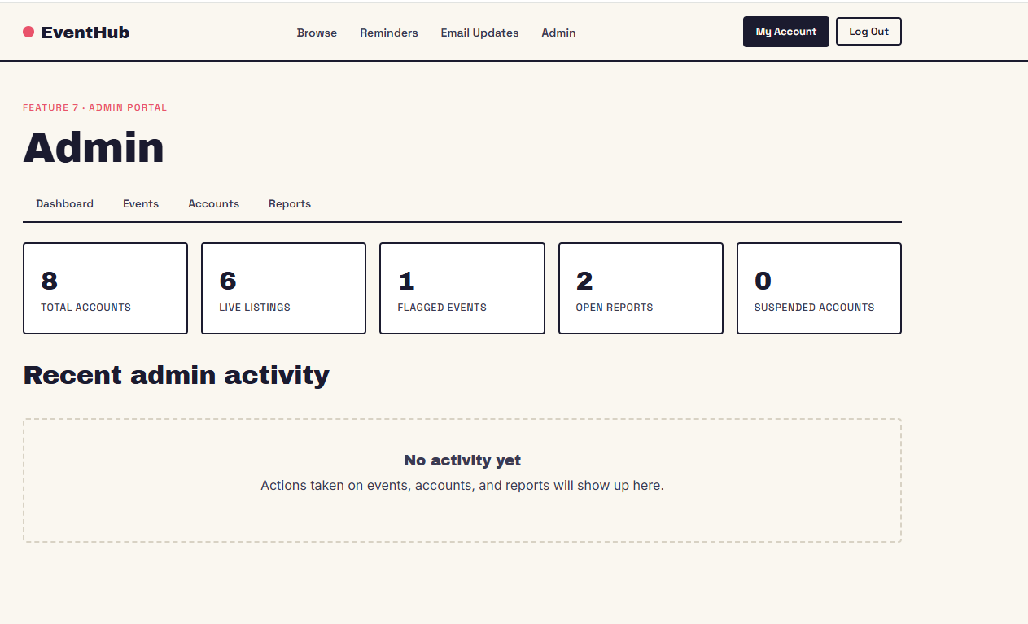
ADMIN portal (DASHBOARD)
Brian
Used by administrators to monitor and manage the platform.
Provides an overview of:
Total user accounts
Live event listings
Flagged events
Open reports
Suspended accounts
Navigation tab :
Dashboard
Events
Accounts
Reports
Dashboard:
Display Key platform statistics
Active user accounts
Live event listings
Flagged events
Open Reports
Suspended Accounts

Slide 15
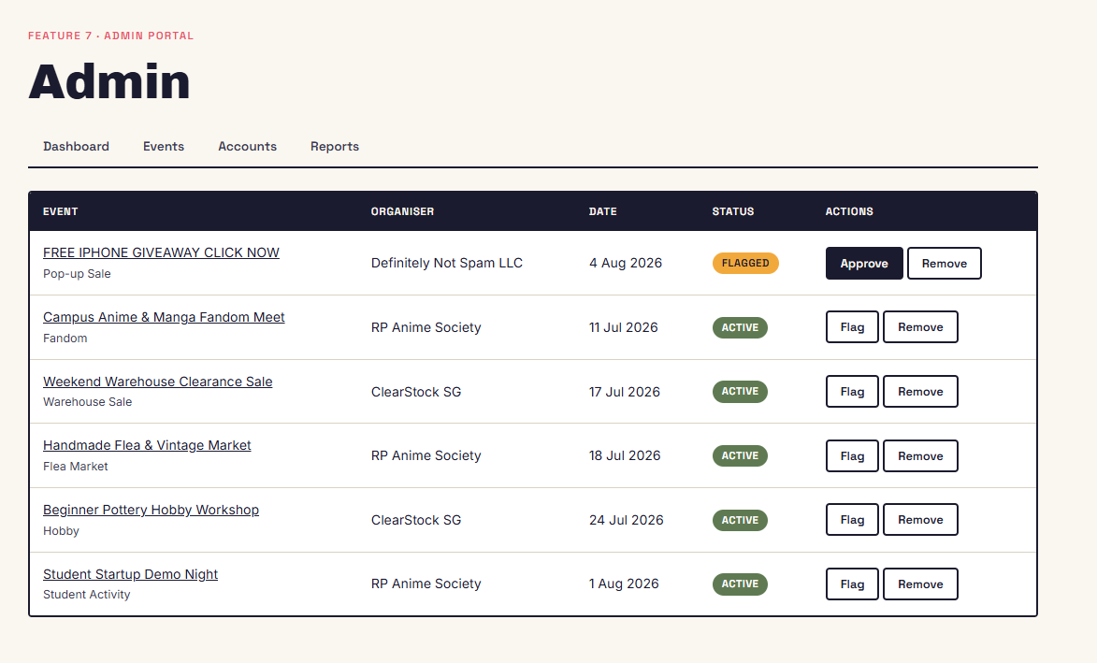
ADMIN portal (events)
Brian
View All Event listings on the platform.
Example of Event categories
iPhone Giveaway
Anime & Manga Fandom Meet
Warehouse Clearance Sale
Flea & Vintage Market
Pottery Workshop
Student Startup
Review listings that they applied with platform guidelines.

Slide 16
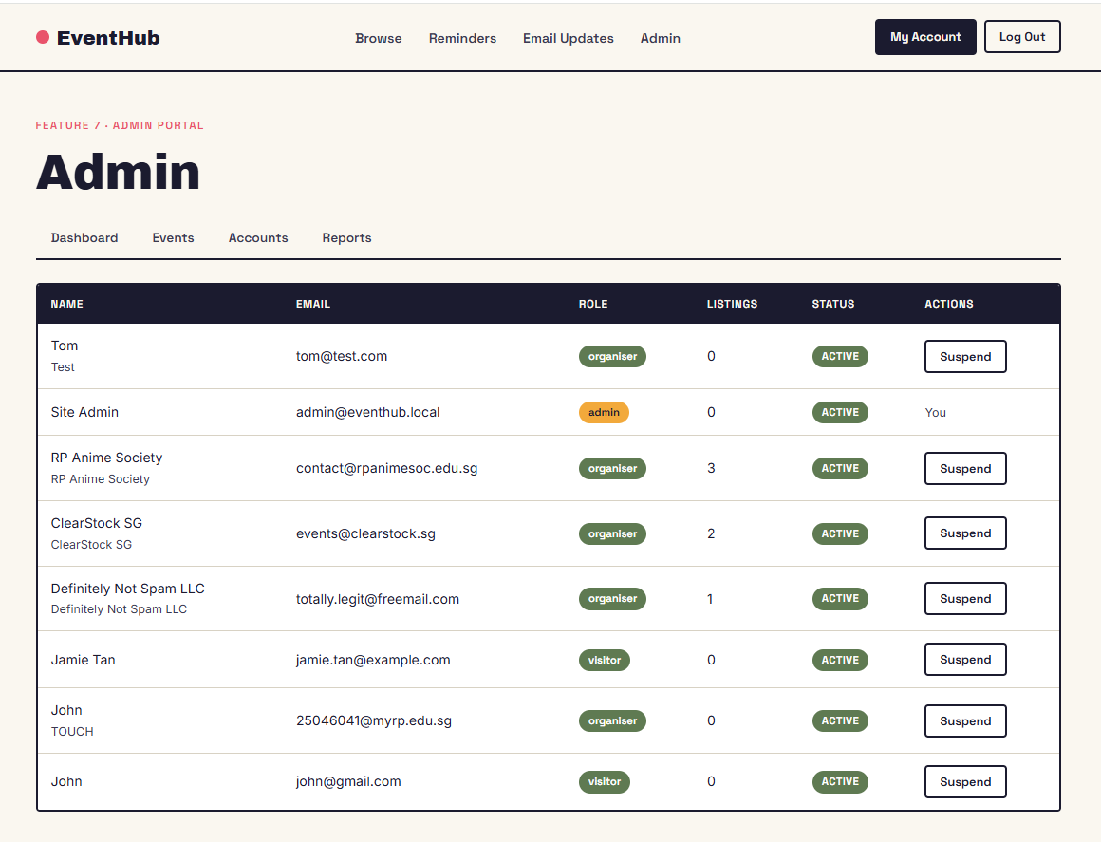
ADMIN portal (Accounts)
Brian
View all registered users on the platform.
Display User Information
User role (Organizer or visitor)
Number of event listings created.
Account Status
Monitor User Activity
Manage and Keep Track of User Records.

Slide 17
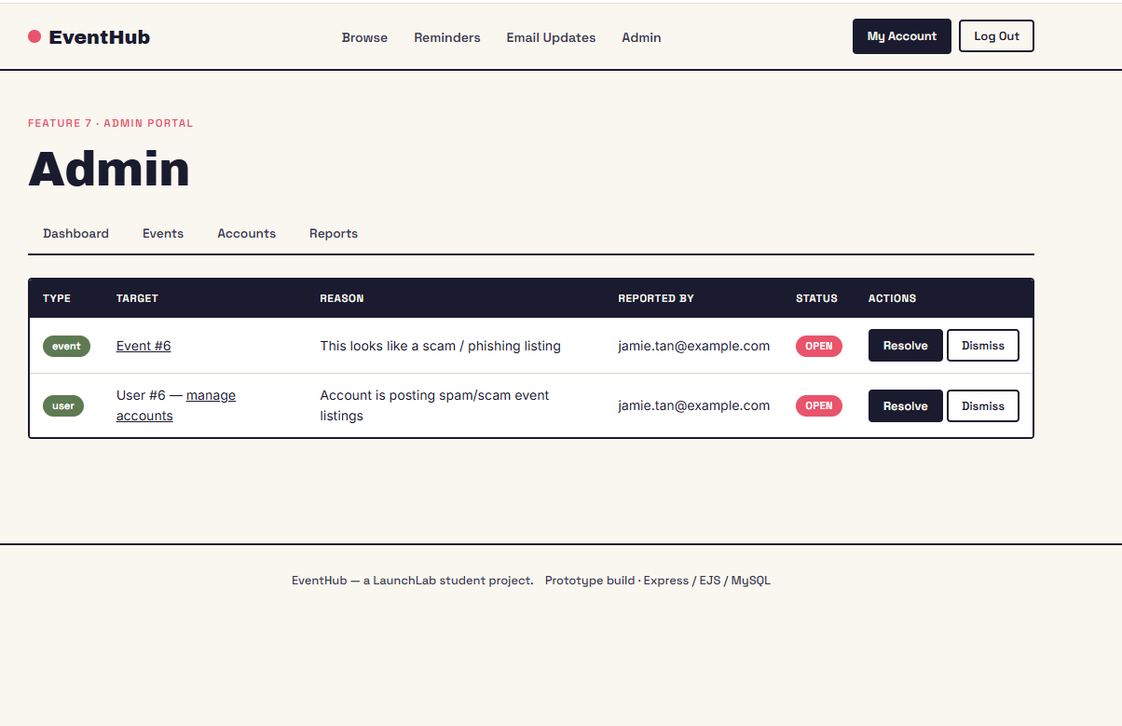
ADMIN portal (reports)
Brian
View all Report submitted by Users
Display details of the Report
Reason for the Report
Report by
Report Status
Review reported issue.
Take appropriate action when necessary.

Slide 18
Members contribution
Member Name | Individual Contribution
Isaiah Chen Jia Shen | 16.7
Chek Ee | 16.7
Yong Ting | 16.7
Haziq | 16.7
Hnin | 16.7
Brian | 16.7

Slide 19
Thank you!

